Slide 1
1/9
Agenda : Specification for LINE-1 Traceability Dashboard.
Prepared by: Shekhar Suman
Checked by: Sumit Sharma

Slide 2
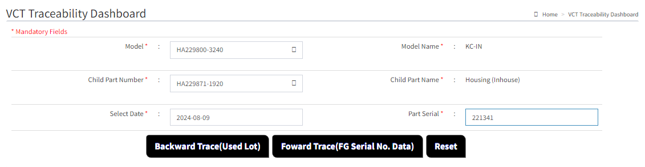

2/9
1. Modify Backward & Forward Traceability , Combined traceability search ,for LINE-2 and LINE 1 separated by line in dashboard for better visualization.
Select Model , Child part Number ,Date, Serial Number and click on the Backward Trace(Used Lot ) Button , new window will appear which will show the Suspected Lot Number Line Wise for Line 2 and Line 1.

Slide 3
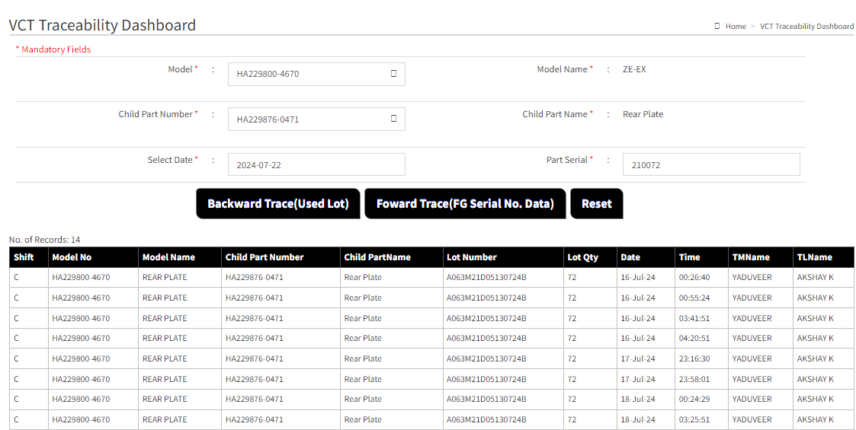
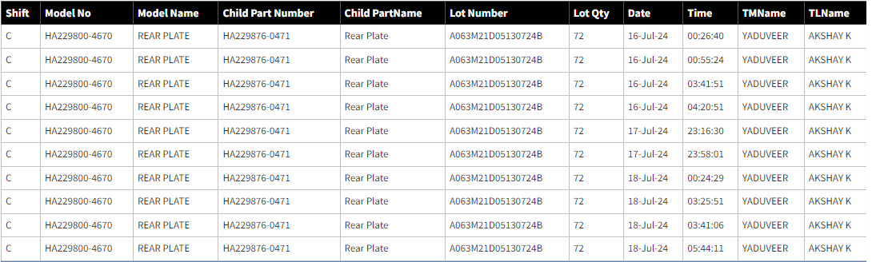
3/9
For L2 Suspected lots.
After traceability it will show the data first for the line which customer claim has been reported after that for another line.
For L1Suspected lots.
Line
2
2
2
2
For Line 2
2
2
2
2
2
2
1
1
For Line 1
1
1
1
1
1
1
From this , we can see the backward lot trace data for both lines( Incase if same lot was used in both line. )
For particular model (incase if Lot was used on only one line , it will show only the data for that line and for another line it will show
* this model is not used on this line.(name of line )

Slide 4
4/9
Incase if the suspected Lot is used on only line 2 , it will show data like this and vice-versa.
Line
2
2
2
2
For Line 2
2
2
2
2
2
2
1
This Lot is not used on the LINE-1

Slide 5
5/9
Suspected Lot Number Line wise .
After getting data for backward Trace ,Click on the Forward Trace Button to get serial number details for suspected lot.
Line
2
2
2
For Line 2
2
2
2
2
2
2
2
1
1
For Line 1
1
1
1
1
1
1

Slide 6
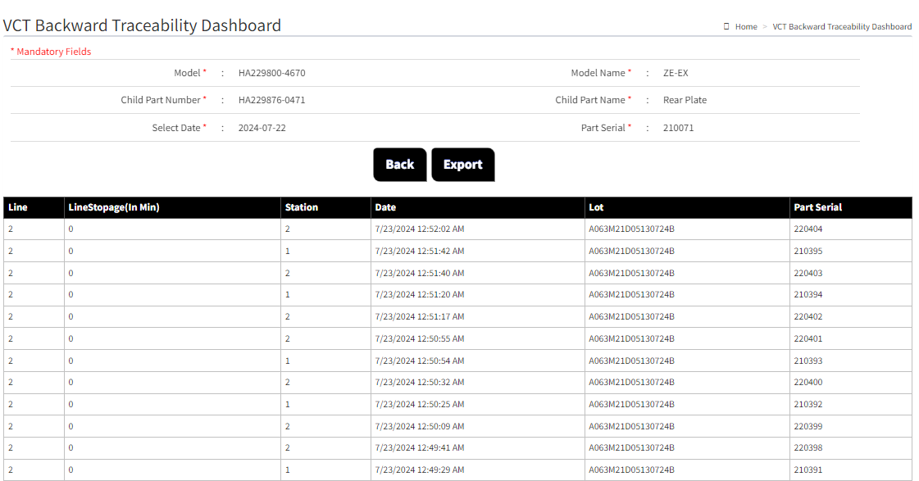
6/9
Suspected Serial Number for Suspected Lot
1
1
1
1
1
1
1
1

Slide 7
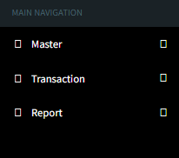

7/9
2. Add new row Lot Info in main Navigation side bar .
VCT Traceability Dashboard
Mandatory fields *
In Main Navigation , Add new Entry Lot Info ,will used for the searching suspected serial number Line wise Using Particular LOT.
Lot Info
Select Line * :
L1
Add new row , Select line *
Select Line from Dropdown Menu.
L2
Model * :
Model Name* :
After modification new Navigation Side bar
Child Part Number * :
Child Part Name * :
Enter Lot * :
Entry desired lot for info.
Add new row ,Enter Lot *
A063M21D05130724B
Add new Button ,Search*
Lot Number

Slide 8
8/9
After clicking on search , it will show the data for that particular LOT entry (A063M21D05130724B), and we should be able to export csv date.
Line
2
2
2
For Line 2
2
2
2
2
2
2
2
1
1
1
For Line 1
1
1
1
1
1

Slide 9
9/9
3. Combine child part name with the child part number
Child Part Number * :
HA229871-0781 (Housing Inhouse)
We will combine child part name with child part number like this for All Models.
HA229861-2410 (Rotor Inhouse)
VN229861-2410 (Rotor CKD)
Pls Modify this like
Child part Number ( Name) *
HA229852-0700 (Sprocket Universal)
229852-0700 (Sprocket CKD)
HA229852-0700 (Sprocket ARUN)
HA229873-0080 (Bush Stopper Local USHA)
HA229873-0080 (Bush Stopper CKD)
HA229865-0170 (Sleeve pin guide)
HA229863-0190 (Pin Stopper Local USHA)
HA229863-0190 (Pin Stopper CKD)
229827-0340 (Bolt)
HA229869-0170 (Bushing Vane Sundaram)
HA229869-1560 (Bushing Vane Porite)
229867-0070 (Spring Stopper)
229884-0010 (Chip Vane seal)
229885-0010 (Spring Vane seal)

